Slide 1
GOOD NOON!
HELLO!
Group Member Group No : 1
Ijaz Ahmed – 1620483042
Asif Anan - 1621358042
Muanna Zilan - 1530810042

Slide 2
Real Time Face Mask Detection

Slide 3
Table of Contents
Introduction
Before starting our presentation
Background
What we do
Methodology
Our awesome projects
Experiment
Our project new ideas
Result
Summary of our data
Conclusion
Keep it touch!

Slide 4
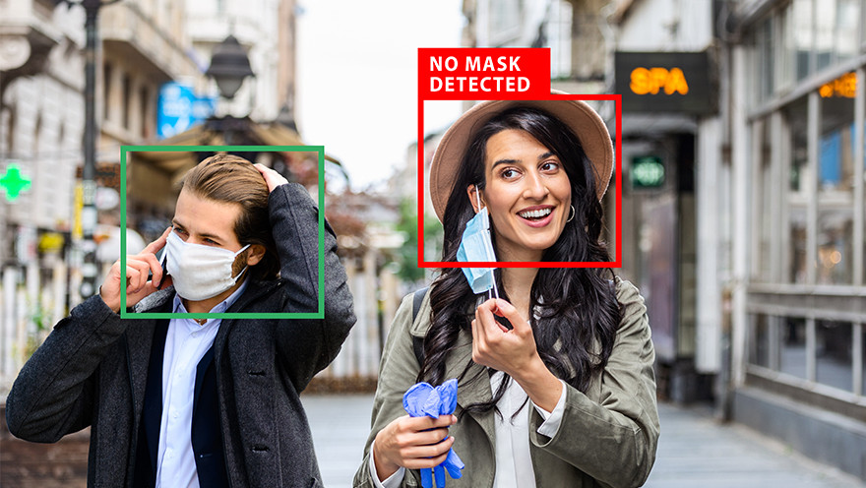

4
INTRODUCTION

Slide 5
Welcome to Our Presentation
Introduction
Idea!
Now a days Covid-19 is a global problem. To ensure safety government announced to wear face mask for everyone.
This rule should be maintained by everyone. But some people don’t follow this rule. Some people don’t wear face mask when they are in public spot.
And police also monitoring face mask safety. But it is not possible for authority to maintain all the time. So, we are building an application which will detect the face mask using camera in real time.
The main goal of this system is to detect the face mask using camera and monitor the activities.
So, this system will help the government or the respective authority to find out who wear face mask and who do not wear mask and take necessary action against those persons.

Slide 6
Introduction
Goal
We are building this system to help the government or the respective authority to detect face mask using CCTV camera in public places.
So, they will get the feedback and can easily monitor all those activities.
This project can be integrated with embedded systems for application in airports, railway stations, offices, schools, and public places to ensure that public safety guidelines are followed.

Slide 7
Overall Strategy
Simple timeline
Step-1
Step-3
Step-5
Start
Split
Result
Web camera or CCTV camera
Video Divided into frames or images
Mask Detection
YES/NO
Record
Processing Block
Capture Video
Data Trains/Test
Distance from camera, eyeline position, facial part detects, nose ,mouth etc.
Step-2
Step-4

Slide 8

8
Background Analysis

Slide 9
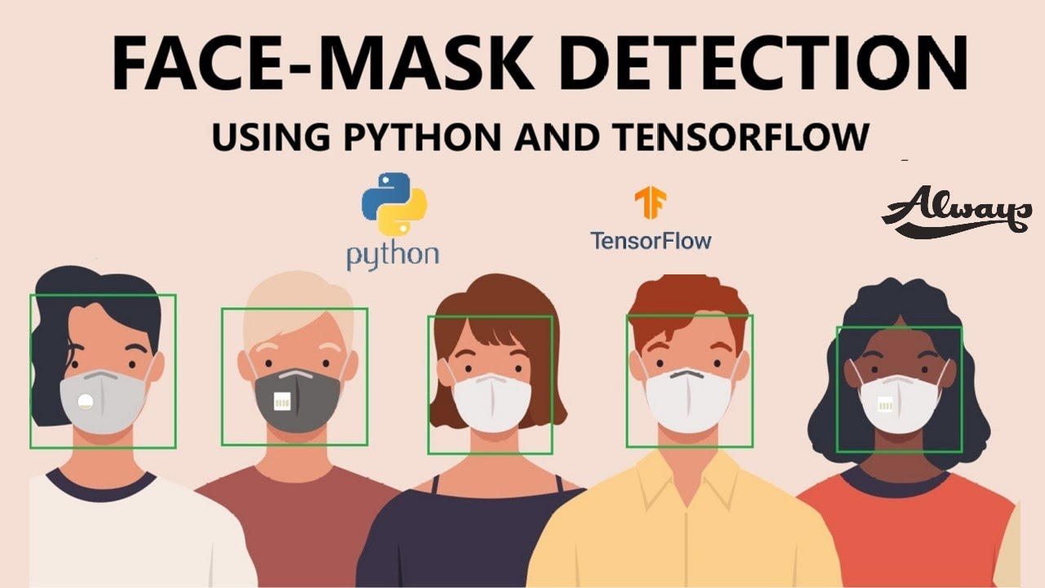



Research Journal
Face Detection
Browsing Internet
We have already read all kind of publication regarding this topic.
We have inspired from face detection project & add custom mask detection code.
Scavenging internet for resources.

Slide 10


10
Methodology

Slide 11






Project Tools
6 points, icons and descriptions
Tenser flow
TensorFlow is a free and open-source software library for machine learning.
Matplotlib
Keras
Matplotlib is a plotting library for the Python programming language..
Keras is an open-source software library that provides a Python interface for artificial neural networks.
Argprase, SciPy
The argparse module makes it easy to write user-friendly command-line interfaces.
Open CV Python
OpenCV is a library of programming functions mainly aimed at real-time computer vision.
NumPy, Imutils
NumPy is a library for the Python programming language, adding support for large, multi-dimensional arrays and matrices.

Slide 12
Phase 1
Train Face Mask Detector
Serialize face mask classifier to disk
.
Train Face mask classifier with TensorFlow
Load Face Mask Dataset

Slide 13
Phase 2
Load Face Mask
5 steps
Classifier from disk
Detect Face
From Web Camera / CCTV
Extract Each Face
From ROI – Region of Interest
Apply Face Mask
Apply Face mask classifier to each face ROI to determine “MASK” or “ NO MASK”
Show Results
YES/NO

Slide 14


14
Experiment

Slide 15
Our Work Throughout Semester
Collecting Dataset
First, we have decided to make our own custom dataset with thousands of face picture. We have found it difficult to collect with face mask picture & no mask picture.
Then , we have searched in open-source library called “Kaggle”. There we have found several datasets which is not perfect for our project. Some dataset has less values which will drive us to less accuracy.
Primarily, we have selected some dataset, Then again, we add some dataset for gaining accuracy.
We change Algorithm & Model. We replace Convolution Neural Network by Mobile NetV2. This gives us better results.

Slide 16
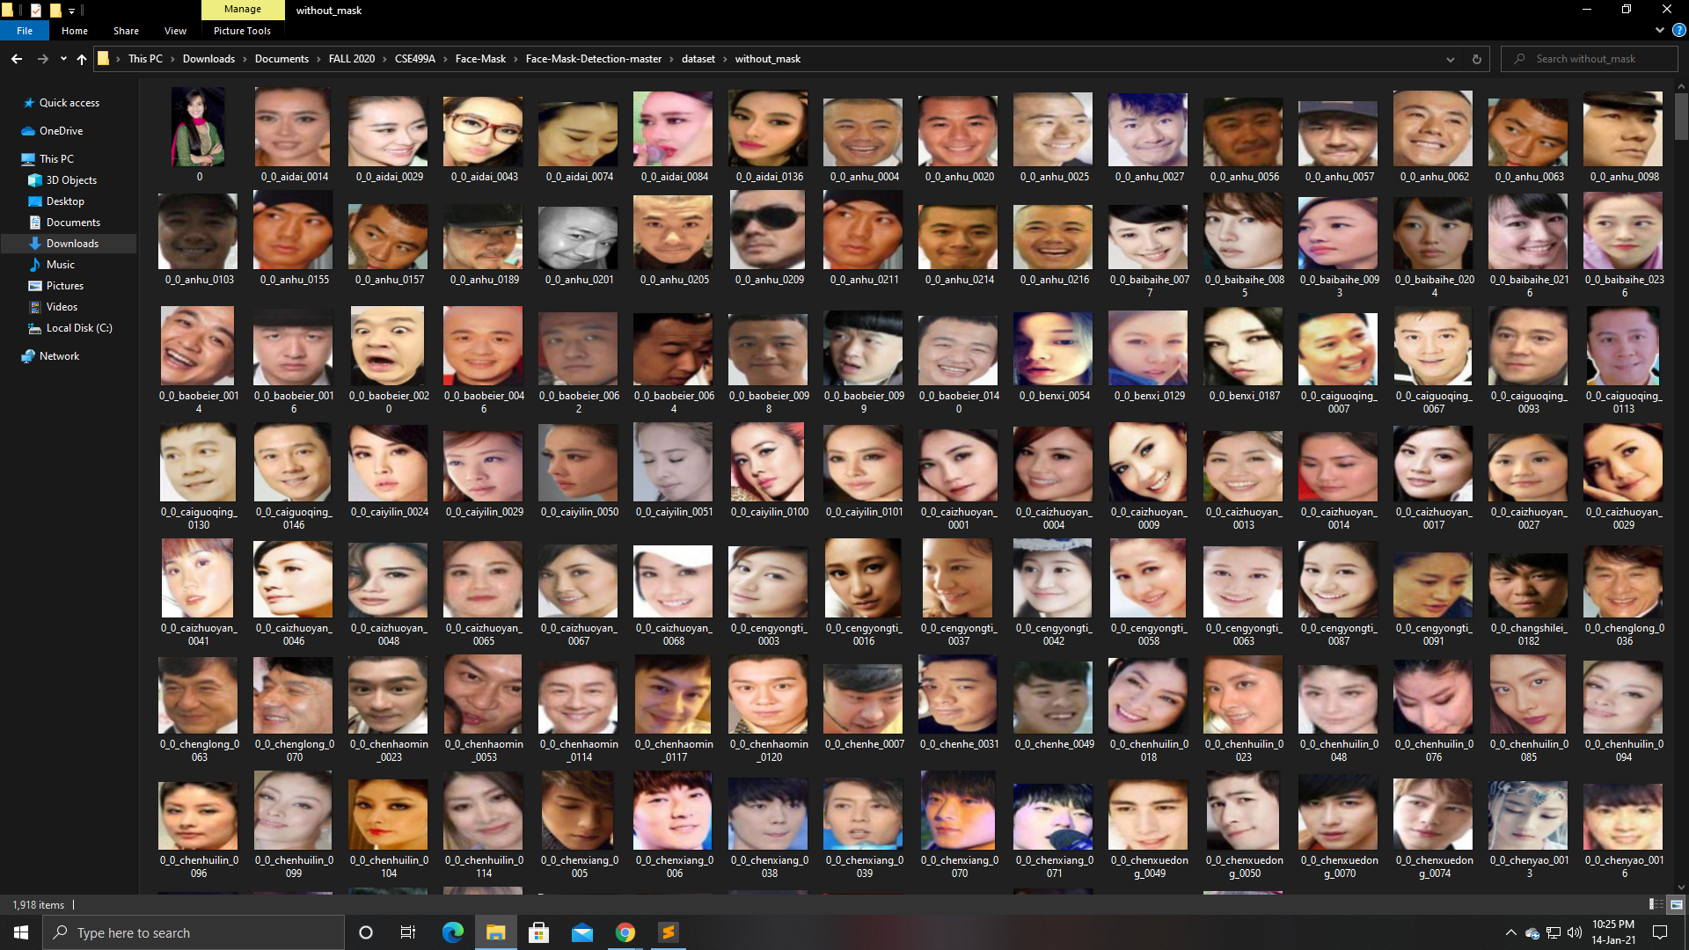
Adding & Collecting Dataset
We have faced a lot of issues to select a moderate dataset. Finally, we select a dataset which contains 3800+ with mask & without mask face.

Slide 17
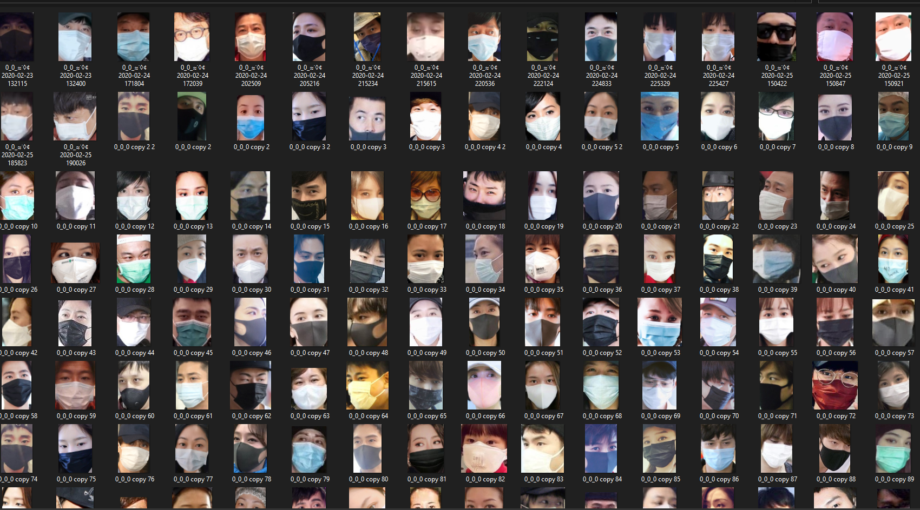
Adding & Collecting Dataset
We have faced a lot of issues to select a moderate dataset. Finally, we select a dataset which contains 3800+ with mask & without mask face. In future we will add more data in our project.

Slide 18
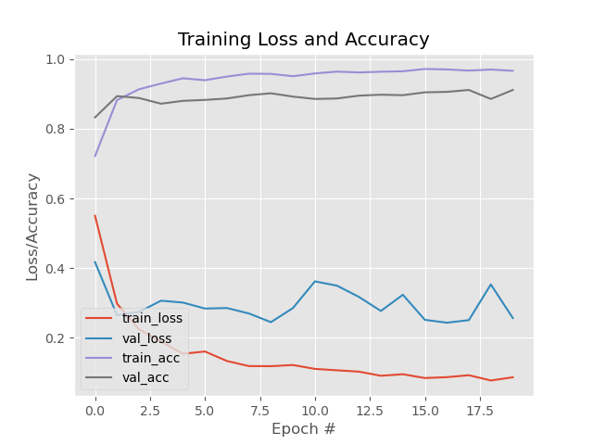
Model Accuracy
We get this accuracy after training our first custom data . So, when we first run our model, our accuracy was average.

Slide 19
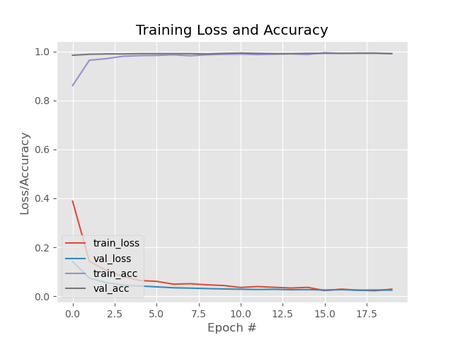
Model Accuracy
After applying Mobile NetV2 model, and add more 1800+ dataset, we overcome his issue. We get this accuracy after second training our custom data .We think this is a good accuracy.

Slide 20
Result
After the implementation of all the points, we get a visual outcome.
Result is very good. We have successfully implemented all the features & detect face mask.

Slide 21
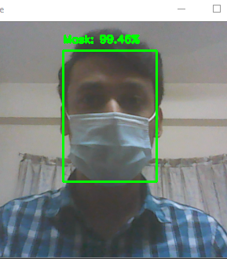
Real Time Face Mask Detection With Mask

Slide 22
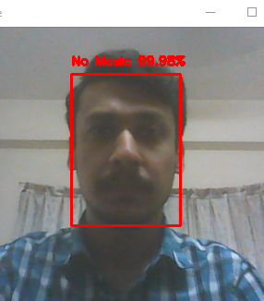
Real Time Face Mask Detection With No Mask

Slide 23
Conclusion
Imagination means nothing without doing.
In Future, we would also like to add more data to test our algorithm to make it more credible for real-world use. Limitations aside, there is room for improvement. The biggest advantage to using an algorithm approach is the ability to replace out an old and inefficient algorithm, with newer and more powerful algorithm when they are developed. There is plenty of room for improvement. The project may be modified and enhanced into something more beautiful and user-friendly over time

Slide 24
Thank You for Watching!
Any Questions?

